Slide 1
C PROGRAMMING
AND
DATA STRUCTURES
BHAVANA
DAY 7
10/04/2024

Slide 2
Introduction to C Programming
History
C programming language was developed by Dennis Ritchie at Bell Labs in the early 1970s. It was designed as a general-purpose programming language to write operating systems and utilities. C became popular due to its simplicity, efficiency, and portability.
Features
C is a procedural programming language, which means it follows a sequential flow of instructions.
It provides low-level access to memory and hardware, making it suitable for system programming.
C is a statically typed language, meaning variable types must be declared before use.
It supports modular programming through the use of functions and libraries.
C has a rich set of operators and control structures, allowing for complex computations and decision-making.

Slide 3
Uses
C programming language is widely used in various domains, including:
System programming: C is used to develop operating systems, device drivers, and firmware.
Embedded systems: C is used to program microcontrollers and other embedded devices.
Game development: C is often used to develop video games due to its efficiency and control over hardware.
Scientific and numerical computing: C is used in scientific research and simulations that require high performance.
Web development: C is used in server-side programming and back-end development.

Slide 4
Variables and Data Types
Variables in C Programming
Variables are used to store data in computer memory.
They have a name, a type, and a value.
The value can be changed during program execution.
Data Types in C
C has several built-in data types, including:
int: used for storing integers
float: used for storing floating-point numbers
char: used for storing single characters
double: used for storing double-precision floating-point numbers

Slide 5
Declaring Variables
Variables must be declared before they can be used.
The declaration specifies the name and type of the variable.
Example: int age; declares a variable named 'age' of type 'int'.
Assigning Values to Variables
Values can be assigned to variables using the assignment operator (=).
Example: age = 25; assigns the value 25 to the variable 'age'.
Operators and Expressions
In C programming, operators are symbols that represent specific actions to be performed on operands. Expressions are combinations of operators, operands, and variables that produce a value. Understanding operators and expressions is essential for writing efficient and effective C programs.

Slide 6
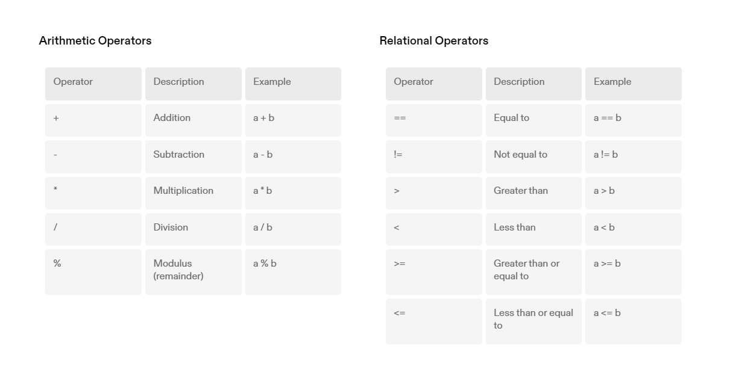

Slide 7
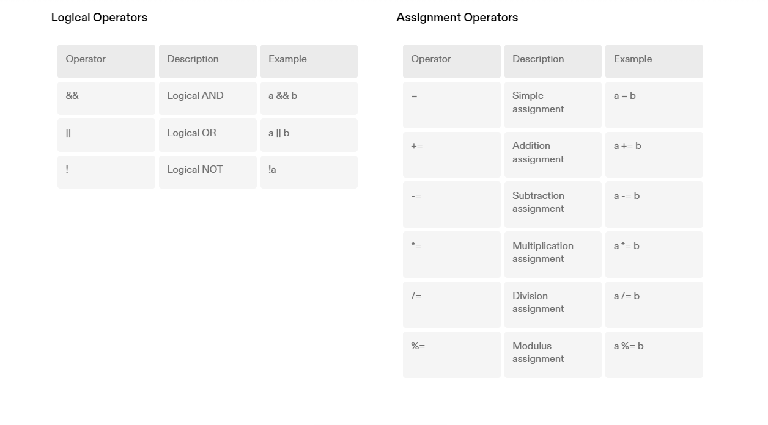

Slide 8
Control Flow
If-Else Statements
If-else statements are used to make decisions in the program based on certain conditions. The program executes different blocks of code depending on whether the condition is true or false.
Loops
Loops are used to repeat a block of code multiple times. There are three types of loops in C programming: while loop, for loop, and do-while loop. Each loop has its own syntax and use cases.
Switch Statements
Switch statements are used to perform different actions based on different conditions. It provides an alternative to using multiple if-else statements.

Slide 9
Functions
Function Declaration
A function declaration tells the compiler about a function's name, return type, and parameters. It does not contain the function body.
Function Definition
A function definition provides the actual implementation of the function. It includes the function body, which contains the statements to be executed when the function is called.
Function Calling
A function is called by its name followed by parentheses. The arguments (if any) are passed inside the parentheses. The function then executes its statements and may return a value.

Slide 10
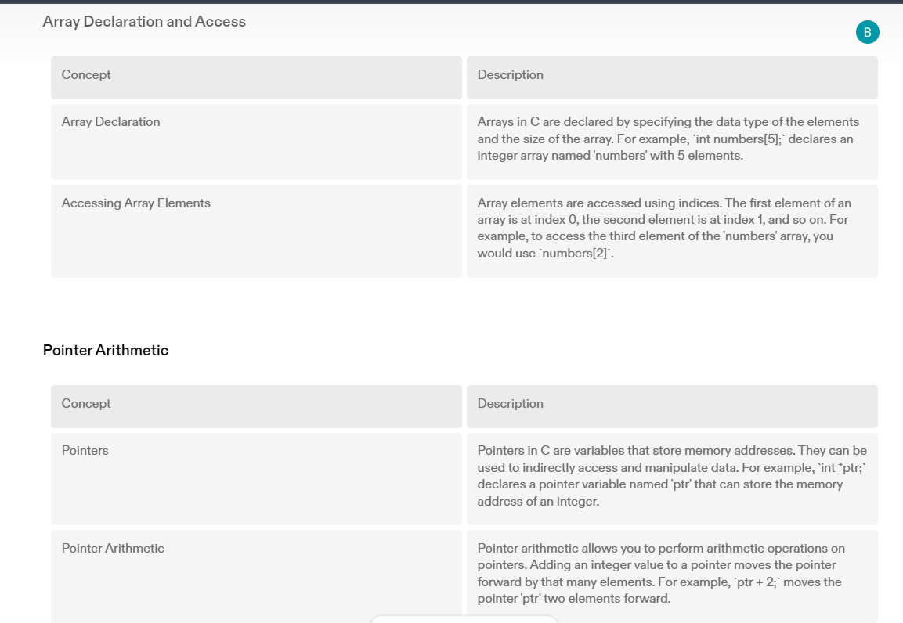
Arrays and Pointers
In C programming, arrays and pointers are fundamental concepts that play a crucial role in manipulating and accessing data. Understanding how to declare arrays, access array elements, and perform pointer arithmetic is essential for efficient programming.

Slide 11
Structures and Unions
Structure Declaration
In C programming, a structure is a user-defined data type that allows you to combine different types of variables under a single name. The declaration of a structure involves specifying the name of the structure and the types of variables it contains. For example:
struct Employee { char name[50]; int age; float salary; };
Accessing Structure Members
To access the members of a structure, you use the dot operator (.) followed by the member name. For example, to access the name member of the Employee structure:
struct Employee emp; strcpy(emp.name, "John Doe");
Union Declaration
In C programming, a union is a user-defined data type that allows you to store different types of data in the same memory location. The declaration of a union is similar to that of a structure, but the memory allocated for a union is equal to the size of its largest member. For example:
union Data { int i; float f; char str[20]; };

Slide 12
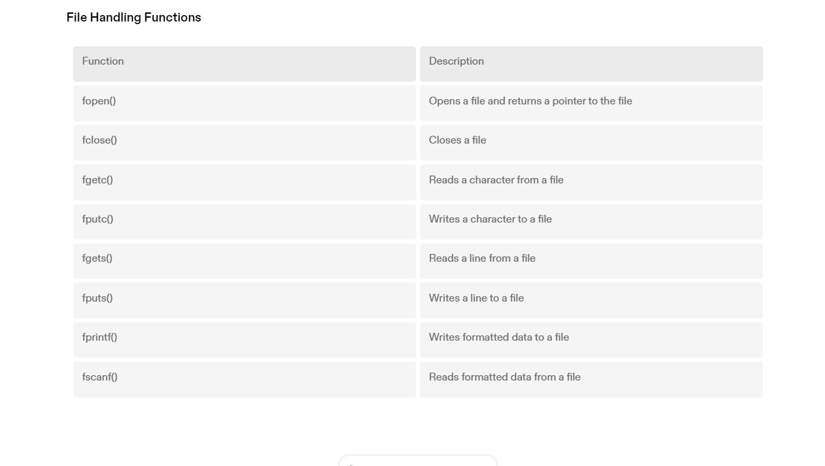

Slide 13
Dynamic Memory Allocation
Malloc
The malloc function is used to dynamically allocate memory in C. It allocates a block of memory of the specified size and returns a pointer to the allocated memory.
Free
The free function is used to deallocate the memory previously allocated by malloc, calloc, or realloc. It frees the memory and makes it available for future use.
Calloc
The calloc function is used to dynamically allocate memory in C. It allocates a block of memory for an array of elements, initializes them to zero, and returns a pointer to the allocated memory.
Realloc
The realloc function is used to resize the previously allocated memory block. It takes the pointer to the previously allocated memory block, the new size, and returns a pointer to the resized memory block.

Slide 14
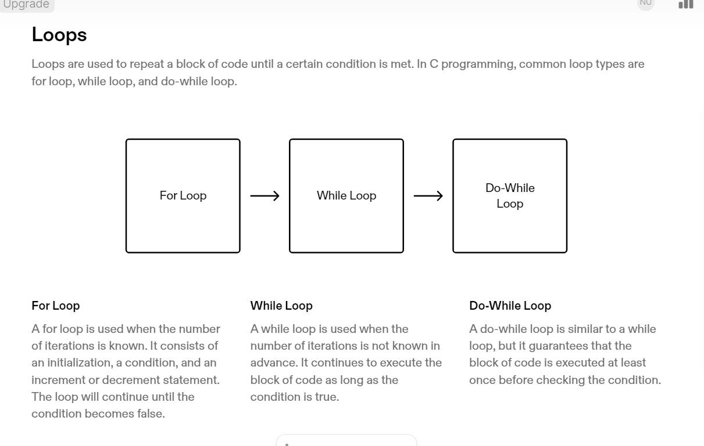

Slide 15
Switch Statements
Switch statements are used to perform different actions based on different conditions. It is an alternative to using multiple if-else statements.
The switch statement evaluates an expression and compares it to multiple case values.
If a match is found, the corresponding block of code is executed.
If no match is found, the default case is executed (if provided).
The break statement is used to exit the switch statement after a match is found.
Example:
int day = 3; switch (day) { case 1: printf("Monday"); break; case 2: printf("Tuesday"); break; case 3: printf("Wednesday"); break; default: printf("Invalid day"); }
Output:
Wednesday

Slide 16
IF-ELSE
If-else statements are used to execute different code blocks based on a condition. The if statement is used to execute code when the condition is true, and the else statement is used to execute code when the condition is false.
Pointers
Pointers are variables that store memory addresses. They are used to manipulate data indirectly and to create dynamic data structures.
Representation of Strings
In C programming, strings are represented as arrays of characters. Each character in the string is stored in a consecutive memory location.

Slide 17
DATA STRUCTURES

Slide 18
Data Structure
A construct that can be defined within a programming language to store a collection of data
one may store some data in an array of integers, an array of objects, or an array of arrays
Abstract Data Type (ADT)
Definition: a collection of data together with a set of operations on that data
specifications indicate what ADT operations do, but not how to implement them
data structures are part of an ADT's implementation
Programmer can use an ADT without knowing its implementation.

Slide 19
Typical Operations on Data
Add data to a data collection
Remove data from a data collection
Lists
List: a finite sequence of data items
a1, a2, a3, ..., an Lists are pervasive in computing e.g. class list, list of chars, list of events
Typical operations:
Creation
Insert/remove an element
Test for emptiness
Find an item/element
Current element/next/previous
Find k-th element
Print the entire list

Slide 20
Array-Based List Implementation
One simple implementation is to use arrays
A sequence of n-elements
Maximum size is anticipated a priority.
Internal variables:
Maximum size maxSize (m)
Current size curSize (n)
Current index cur
Array of elements listArray

Slide 21
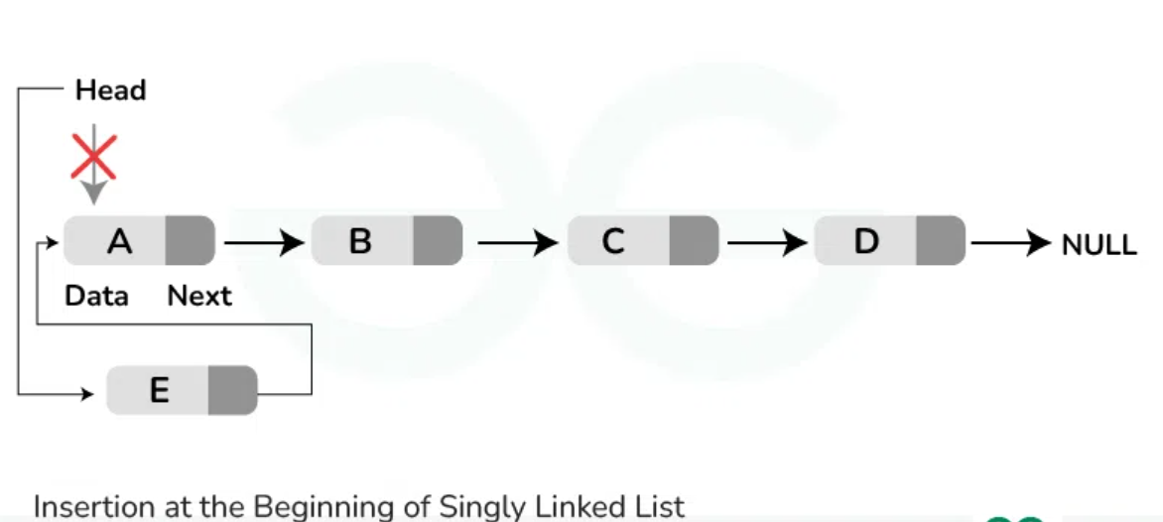
Pointer-Based Linked Lists
The head pointer points to the first node in a linked list
If head is NULL, the linked list is empty
head=NULL
head=malloc(sizeof(Node))

Slide 22
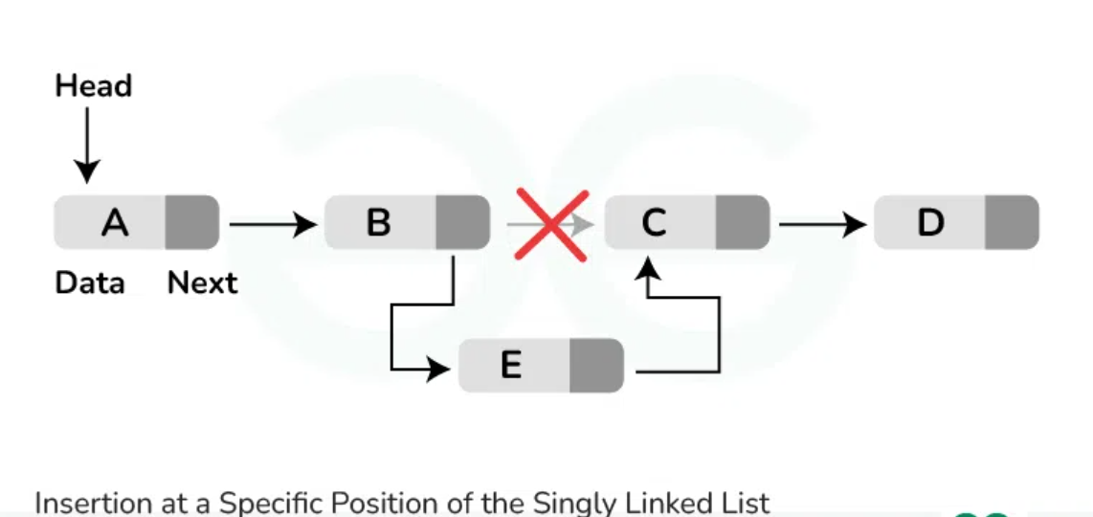
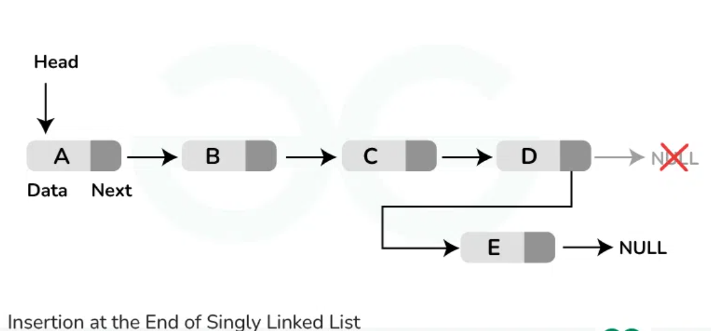

Slide 23
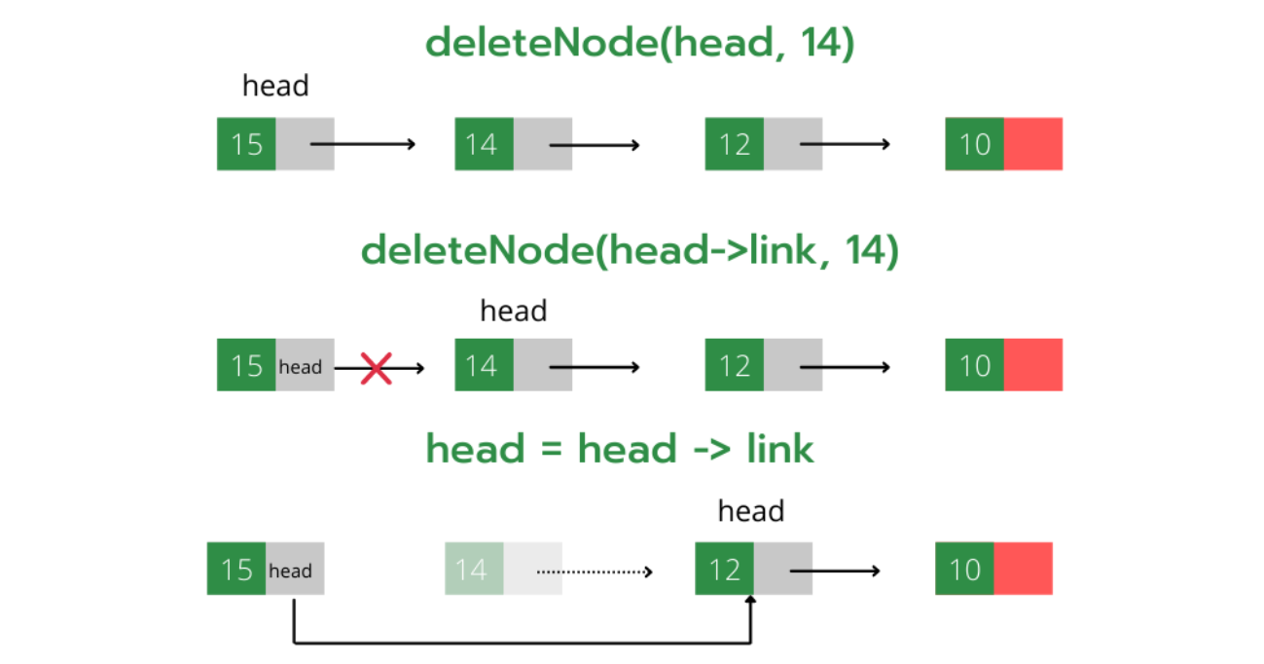
DELETING A NODE:

Slide 24
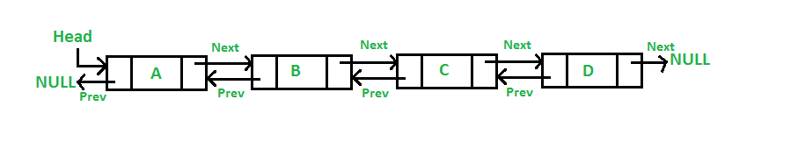
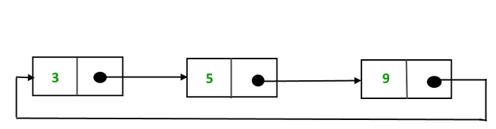
DOUBLY LINKED LIST:
CIRCULAR LINKED LIST:

Slide 25
STACK:
A stack is a list with the restriction that insertions and deletions can be performed in only one position, namely, the end of the list, called the top.
The operations: push (insert) and pop (delete)
The main functions in the Stack ADT are (S is the stack)
boolean isEmpty(); // return true if empty
boolean isFull(S); // return true if full
void push(S, item); // insert item into stack
void pop(S); // remove most recent item
void clear(S); // remove all items from stack
Item top(S); // retrieve most recent item
Item topAndPop(S); // return & remove most recent item

Slide 26
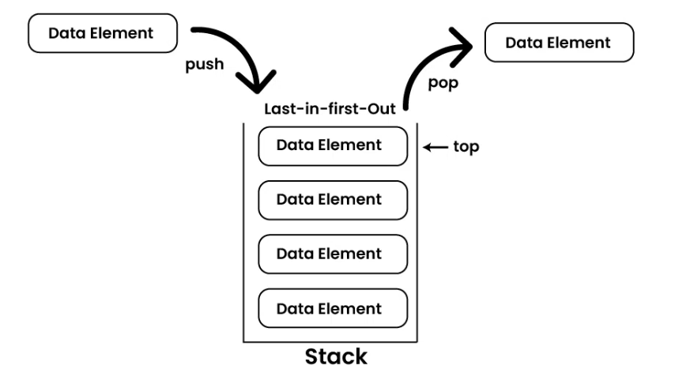

Slide 27
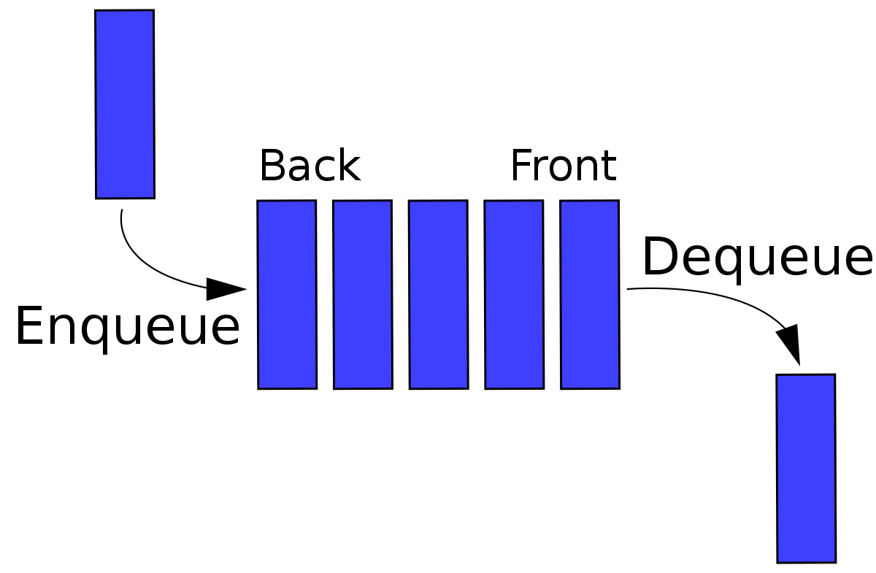
QUEUE
Like stacks, queues are lists. With a queue, however, insertion is done at one end whereas deletion is done at the other end.
Queues implement the FIFO (first-in first-out) policy. E.g., a printer/job queue!
Two basic operations of queues:
dequeue: remove an item/element from front
enqueue: add an item/element at the back

Slide 28
The main functions in the Queue ADT are (Q is the queue)
void enqueue(o, Q) // insert o to back of Q
void dequeue(Q); // remove oldest item
Item getFront(Q); // retrieve oldest item
boolean isEmpty(Q); // checks if Q is empty
boolean isFull(Q); // checks if Q is full
void clear(Q); // make Q empty

Slide 29
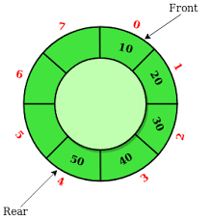
CIRCULAR ARRAY:
To implement queue, it is best to view arrays as circular structure

Slide 30


